Slide 1
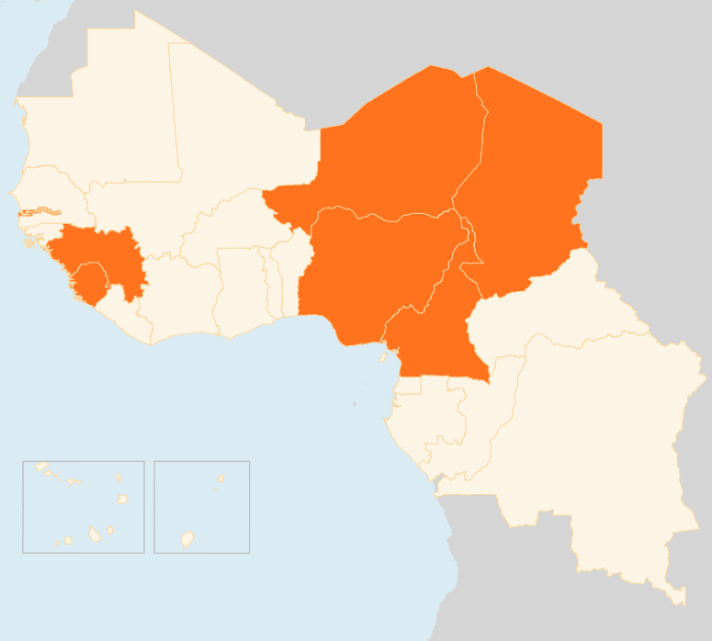


9 – 15 June 2015
CHAD
23 KILLED IN SUICIDE BLASTS
On 15 June, two simultaneous suicide bombings outside the police headquarters and police academy in the capital N’Djamena killed at least 23 people. There was no immediate claim of responsibility, but Boko Haram militants have in the past threatened to attack Chad and neighbouring countries for battling the militant group. The attack is the first of its kind in Chad. Up to now, Boko Haram has mainly targeted Chadian villages on the shores of Lake Chad.
CELEBRATING THREE POLIO-FREE YEARS
On 12 June, Chad celebrated polio-free status for the third consecutive year, marking a vital milestone towards eradicating the Wild Poliovirus in the country. The achievement is due to the continued engagement of the Chadian government and the close collaboration with UNICEF, WHO, other polio partners and donors. Strong efforts have been made to maintain rigorous supplementary immunization activities.
CAMEROON
BOKO HARAM MAKE MORE INCURSIONS INTO CAMEROON
Facing military pressure, Boko Haram appears to be making more cross-border raids into Cameroon for food supplies or to escape Nigerian and regional forces. Over the past week, the militants attacked and looted a village near Fotokol border area. They also looted trucks on a key highway. Local authorities believe the militants are now opting for isolated but targeted attacks, which pose great danger for humanitarian missions in remote areas.
NIGER
18 MIGRANTS FOUND DEAD IN DESERT
The bodies of 18 migrants (17 men and one woman) have been found in the desert near Arlit town in northern Niger, IOM said on 14 June. The migrants, mainly West Africans, are thought to have died of dehydration on 3 June after losing their way during a sandstorm. Nearly 50,000 migrants so far this year have been rescued in the waters between Libya’s coast and Italy. The inland journey is no less arduous and many deaths could be going unreported due to lack of systematic information collection or rescue operations.
NIGERIA
10 KILLED IN BLASTS, MILITARY HQ MOVED
On 15 June, 10 people were killed in twin bombings in Potiskum town in the northern Yobe State. No one claimed responsibility, but the city has been repeatedly hit by Boko Haram. The attack came a week after Nigeria announced it was moving its military headquarters to Maiduguri city in Borno State, the birth place of Boko Haram. Nigeria has also taken the lead of a joint regional force set up to counter the militants.
EVD GUINEA/SIERRA LEONE
DECLINE IN INFECTION STALLS
The decline in EVD cases seen in April and May has stopped, with 31 cases reported in Guinea and Sierra Leone in the week to 7 June - the second consecutive week that infections have risen. The wider geographic area of transmission and the continued occurrence of cases from unknown sources highlight the challenges still faced in finding and eliminating every chain of transmission. In the week to 14 June, 24 new cases were reported (19 in Sierra Leone and five in Guinea), according to preliminary WHO reports.
WEST AFRICA
NEED FOR BETTER DISASTER MANAGEMENT
On 10 June, the Regional Committee on Disaster Management in West Africa (GECEAO) called for better preparedness and anticipation to alleviate hardship faced by communities in the wake of natural or man-made disasters. This year, more than 27 million people are facing food insecurity, among them 4.7 million in need of immediate food assistance. The 8 - 10 June GECEAO consultations in Abidjan agreed to work to harmonise disaster risk management methodologies, make better use of existing data and ensure that information products are simplified.
NIGER
CHAD
23
KILLED IN SUICIDE BOMBINGS
18
MIGRANTS FOUND DEAD IN DESERT
POLIO-FREE YEARS
3
NIGERIA
10
KILLED IN BLASTS
CAMEROON
MILITANTS STAGE MORE RAIDS
EVD GUINEA/ SIERRA LEONE
DECLINE IN CASES HALTS
Creation date: 16 June 2015
Map data sources: UNCS, DevInfo, OCHA.
The boundaries and names shown and the designations used on this map do not imply official endorsement or acceptance by the United Nations

